Slide 1

CHAPTER 9
COUNTING AND PROBABILITY
Copyright © Cengage Learning. All rights reserved.

Slide 2

9.9
Conditional Probability, Bayes’ Formula, and Independent Events
Copyright © Cengage Learning. All rights reserved.

Slide 3
Conditional Probability

Slide 4
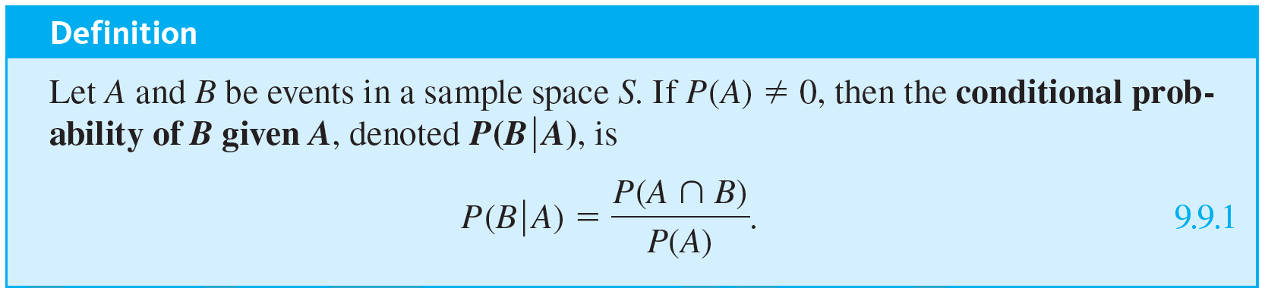
Conditional Probability

Slide 5
Example 9.9.1 – Computing a Conditional Probability
A pair of fair dice, one blue and the other gray, are rolled. What is the probability that the sum of the numbers showing face up is 8, given that both of the numbers are even?

Slide 6
Example 9.9.1 – Solution
The sample space is the set of all 36 outcomes obtained from rolling the two dice and noting the numbers showing face up on each.
As in earlier section, denote by ab the outcome that the number showing face up on the blue die is a and the one on the gray die is b.
Let A be the event that both numbers are even and B the event that the sum of the numbers is 8.

Slide 7
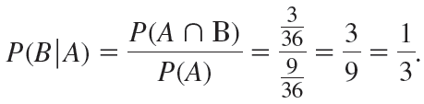
Example 9.9.1 – Solution
continued
Then A = {22, 24, 26, 42, 44, 46, 62, 64, 66}, B = {26, 35, 44, 53, 62}, and A ∩ B = {26, 44, 62}.
Because the dice are fair (so all outcomes are equally likely), P(A) = 9 ∕ 36, P(B) = 5 ∕ 36, and P(A ∩ B) = 3 ∕ 36. By definition of conditional probability,

Slide 8


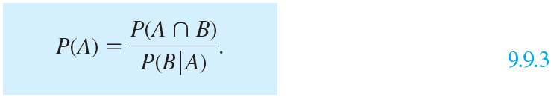
Conditional Probability
Note that when both sides of the formula for conditional probability (formula 9.9.1) are multiplied by P(A), a formula for P(A ∩ B) is obtained:
And dividing both sides of formula (9.9.2) by
gives a formula for P(A):

Slide 9
Bayes’ Theorem

Slide 10
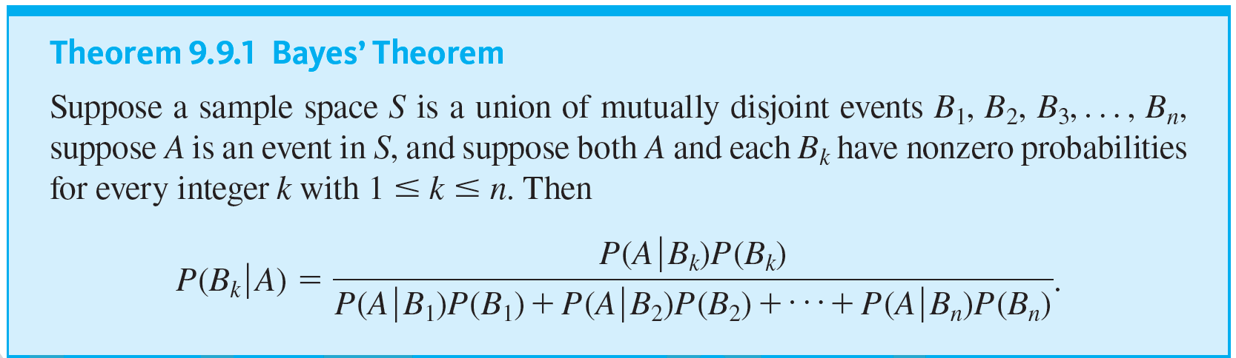
Bayes’ Theorem
Thomas Bayes was an English Presbyterian minister who devoted much of his energies to mathematics. The theorem that bears his name was published posthumously in 1763. The portrait at the left is the only one attributed to him, but its authenticity has recently come into question.

Slide 11
Example 9.9.3 – Applying Bayes’ Theorem
Most medical tests occasionally produce incorrect results, called false positives and false negatives.
When a test is designed to determine whether a patient has a certain disease, a false positive result indicates that a patient has the disease when the patient does not have it.
A false negative result indicates that a patient does not have the disease when the patient does have it.

Slide 12
Example 9.9.3 – Applying Bayes’ Theorem
continued
When large-scale health screenings are performed for diseases with relatively low incidence, those who develop the screening procedures have to balance several considerations: the per-person cost of the screening, follow-up costs for further testing of false positives, and the possibility that people who have the disease will develop unwarranted confidence in the state of their health.
Consider a medical test that screens for a disease found in 5 people in 1,000. Suppose that the false positive rate is 3% and the false negative rate is 1%.

Slide 13
Example 9.9.3 – Applying Bayes’ Theorem
continued
Then 99% of the time a person who has the condition tests positive for it, and 97% of the time a person who does not have the condition tests negative for it.
a. What is the probability that a randomly chosen person who tests positive for the disease actually has the disease?
b. What is the probability that a randomly chosen person who tests negative for the disease does not in fact have the disease?

Slide 14
Example 9.9.3 – Solution
Consider a person chosen at random from among those screened.
Let A be the event that the person tests positive for the disease, B₁ the event that the person actually has the disease, and B₂ the event that the person does not have the disease. Then

Slide 15


Example 9.9.3 – Solution
continued
Also, because 5 people in 1,000 have the disease,
P(B₁) = 0.005 and P(B₂) = 0.995.
a. By Bayes’ theorem,
≅ 0.1422 ≅ 14.2%.

Slide 16


Example 9.9.3 – Solution
continued
Thus the probability that a person with a positive test result actually has the disease is approximately 14.2%.
b. By Bayes’ theorem,
≅ 0.999948 ≅ 99.995%.

Slide 17
Example 9.9.3 – Solution
continued
Thus the probability that a person with a negative test result does not have the disease is approximately 99.995%.
You might be surprised by these numbers, but they are fairly typical of the situation where the screening test is significantly less expensive than a more accurate test for the same disease yet produces positive results for nearly all people with the disease.

Slide 18
Example 9.9.3 – Solution
continued
Using the screening test limits the expense of unnecessarily using the more costly test to a relatively small percentage of the population being screened, while only rarely indicating that a person who has the disease is free of it.

Slide 19
Independent Events

Slide 20
Independent Events
Suppose a fair coin is tossed twice. It seems intuitively clear that the outcome of the first toss does not depend in any way on the outcome of the second toss, and conversely, the outcome of the second toss does not depend on the outcome of the first toss.
In other words, if, for instance, A is the event that a head is obtained on the first toss and B is the event that a head is obtained on the second toss, then if the coin is tossed randomly both times, events A and B should be independent in the sense that

Slide 21
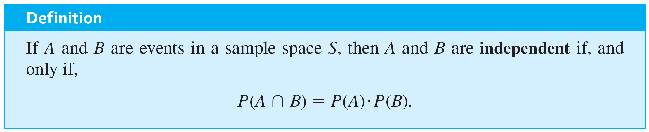
Independent Events

Slide 22

Example 9.9.4 – Disjoint Events and Independence
Let A and B be events in a sample space S, and suppose
P(A) ≠ 0, and P(B) ≠ 0. Show that
P(A ∩ B) ≠ P(A) · P(B).

Slide 23

Example 9.9.4 – Solution
Because
by probability axiom 2. But P(A) · P(B) ≠ 0 because neither P(A) nor P(B) equals zero.
Thus P(A ∩ B) ≠ P(A) · P(B).

Slide 24
Example 9.9.6 – Computing Probabilities of Intersections of Two Independent Events
A coin is loaded so that the probability of heads is 0.6. Suppose the coin is tossed twice.
Although the probability of heads is greater than the probability of tails, there is no reason to believe that whether the coin lands heads or tails on one toss will affect whether it lands heads or tails on the other toss.
Thus it is reasonable to assume that the results of the tosses are independent.

Slide 25
Example 9.9.6 – Computing Probabilities of Intersections of Two Independent Events
continued
a. What is the probability of obtaining two heads?
b. What is the probability of obtaining one head?
c. What is the probability of obtaining no heads?
d. What is the probability of obtaining at least one head?

Slide 26
Example 9.9.6 – Solution
The sample space S consists of the four outcomes {HH, HT, TH, TT}, which are not equally likely.
Let E be the event that a head is obtained on the first toss, and let F be the event that a head is obtained on the second toss.
Then P(E) = P(F) = 0.6, and it is to be assumed that E and F are independent.

Slide 27

Example 9.9.6 – Solution
continued
a. The event of obtaining two heads is E ∩ F. And because E and F are independent,
P(two heads) = P(E ∩ F) = P(E) · P(F) = (0.6)(0.6)
= 0.36 = 36%.
b. One head can be obtained in two mutually exclusive ways: head on the first toss and tail on the second, or tail on the first toss and head on the second. Thus, the event of obtaining exactly one head is

Slide 28
Example 9.9.6 – Solution
continued
Also
and, moreover, by the formula for the probability of the complement of an event,
Hence
= (0.6)(0.4) + (0.4)(0.6)
= 0.48 = 48%.
c. The event of obtaining no heads is

Slide 29
Example 9.9.6 – Solution
continued
Thus,
= (0.4)(0.4) = 0.16 = 16%.
d. There are two ways to solve this problem. One is to observe that because the event of obtaining one head and the event of obtaining two heads are mutually disjoint,
P(at least one head) = P(one head) + P(two heads)

Slide 30
Example 9.9.6 – Solution
continued
= 0.48 + 0.36 by parts (a) and (b)
= 0.84
= 84%.
The second way is to use the fact that the event of obtaining at least one head is the complement of the event of obtaining no heads. So
P(at least one head) = 1 − P(no heads)
= 1 − 0.16 by part (c)
= 0.84 = 84%.

Slide 31
Example 9.9.7 – Expected Value of Tossing a Loaded Coin Twice
Suppose that a coin is loaded so that the probability of heads is 0.6, and suppose the coin is tossed twice.
If this experiment is repeated many times, what is the expected value of the number of heads?

Slide 32
Example 9.9.7 – Solution
Think of the outcomes of the coin tosses as just 0, 1, or 2 heads.
Example 9.9.6 showed that the probabilities of these outcomes are 0.16, 0.48, and 0.36, respectively.
Thus, by definition of expected value, the
expected number of heads = 0 · (0.16) + 1 · (0.48) + 2 · (0.36)
= 1.2.

Slide 33
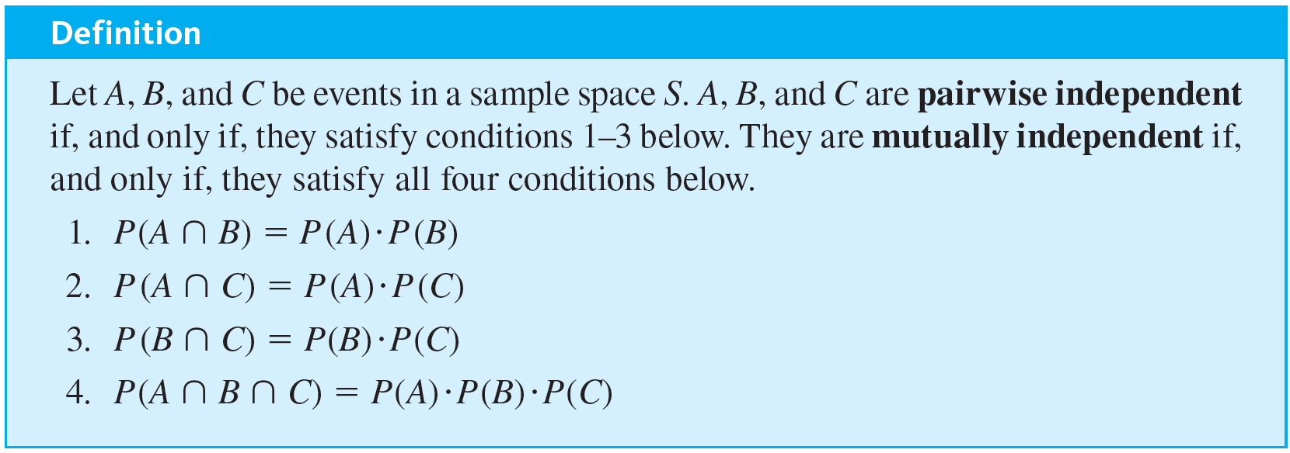
Independent Events
Four conditions must be included in the definition of independence for three events.

Slide 34
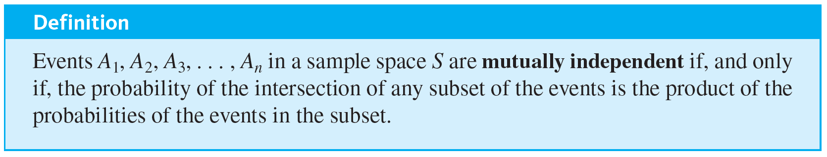
Independent Events
The definition of mutual independence for any collection of n events with n ≥ 2 generalizes the two definitions given previously.

Slide 35
Example 9.9.9 – Tossing a Loaded Coin Ten Times
A coin is loaded so that the probability of heads is 0.6 (and thus the probability of tails is 0.4). Suppose the coin is tossed ten times. As in Example 9.9.6, it is reasonable to assume that the results of the tosses are mutually independent.
a. What is the probability of obtaining eight heads?
b. What is the probability of obtaining at least eight heads?

Slide 36
Example 9.9.9 – Solution
a. For each i = 1, 2, . . . , 10, let H_{i} be the event that a head is obtained on the i th toss, and let T _{i} be the event that a tail is obtained on the i th toss.
Suppose that the eight heads occur on the first eight tosses and that the remaining two tosses are tails. This is the event
H₁ ∩ H₂ ∩ H₃ ∩ H₄ ∩ H₅ ∩ H₆ ∩ H₇ ∩ H₈ ∩ T₉ ∩ T₁₀.
For simplicity, we denote it as HHHHHHHHTT.

Slide 37
Example 9.9.9 – Solution
continued
By definition of mutually independent events,
Because of the commutative law for multiplication, if the eight heads occur on any other of the ten tosses, the same number is obtained. For instance, if we denote the event H₁ ∩ H₂ ∩ T₃ ∩ H₄ ∩ H₅ ∩ H₆ ∩ H₇ ∩ H₈ ∩ T₉ ∩ H₁₀ by H H T H H H H H T H, then

Slide 38


Example 9.9.9 – Solution
continued
Now there are as many different ways to obtain eight heads in ten tosses as there are subsets of eight elements (the toss numbers on which heads are obtained) that can be chosen from a set of ten elements.
This number is
It follows that, because the different ways of obtaining eight heads are all mutually exclusive,

Slide 39
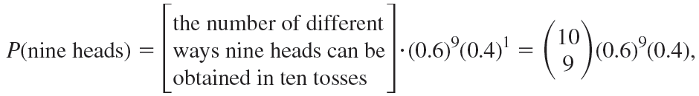
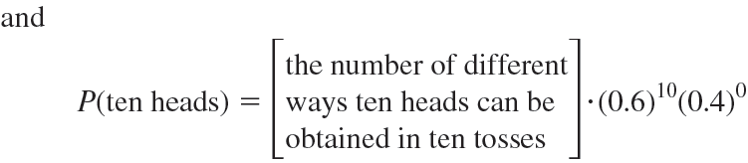
Example 9.9.9 – Solution
continued
b. By reasoning similar to that in part (a),

Slide 40
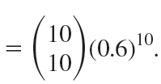

Example 9.9.9 – Solution
continued
Because obtaining eight, obtaining nine, and obtaining ten heads are mutually disjoint events,
P(at least eight heads) = P(eight heads) +
P(nine heads) + P(ten heads)

Slide 41
Example 9.9.9 – Solution
continued
≅ 0.167
= 16.7%.

Slide 42

Independent Events
Probabilities of the form
where 0 ≤ p ≤ 1, are called binomial probabilities.

